Slide 1
HR
Dashboard

Slide 2

Team Members
Muhammad Abdel Azim
Tamer Rashad
Muhammad Dawood
Ahmed Saad

Slide 3

Idea of project and purpose
Report & analysis of company
Report & analysis company employee performance
Report & analysis company department performance

Slide 4

Data source
- Excel and CSV files from DEPI

Slide 5
Stages of project
Cleaning
Modeling
DAX
Sample visual
Reports
Dashboard

Slide 6
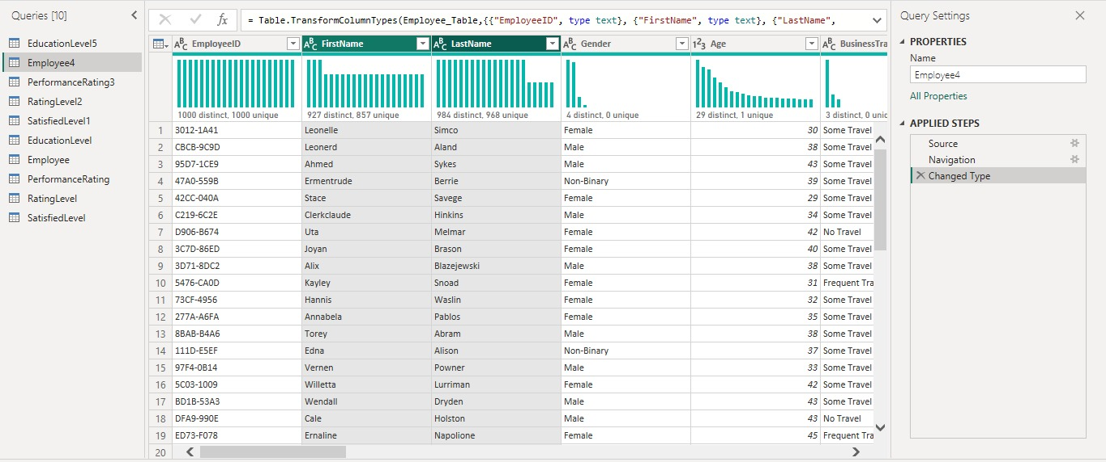
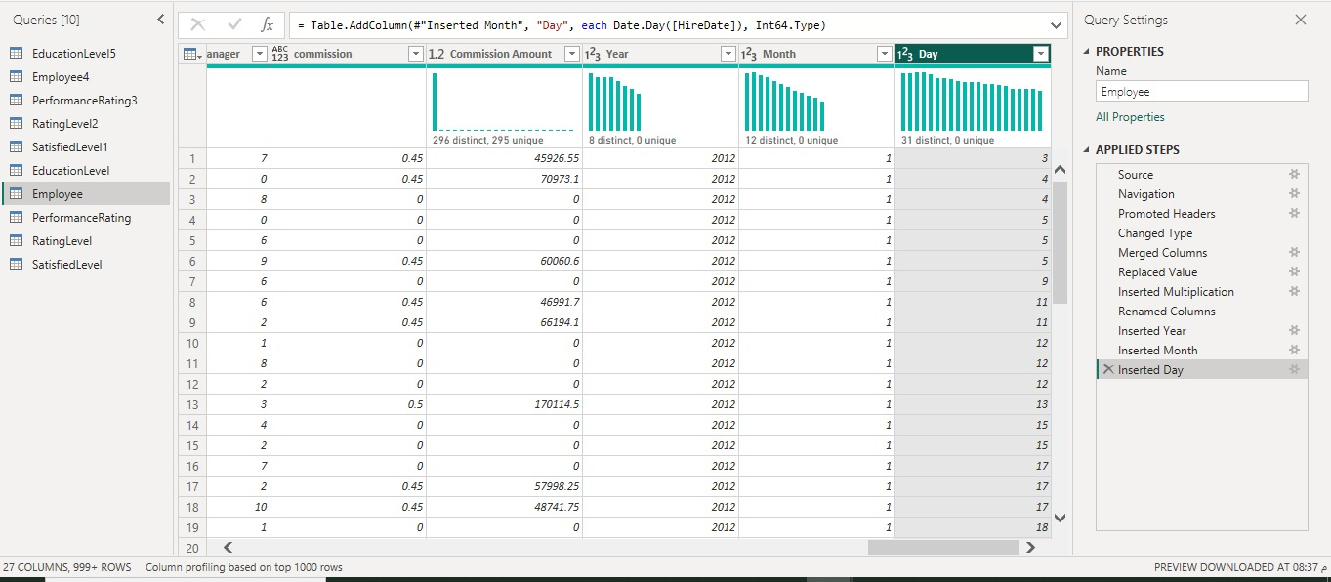
Cleaning
Data Before Cleaning
Data After Cleaning

Slide 7
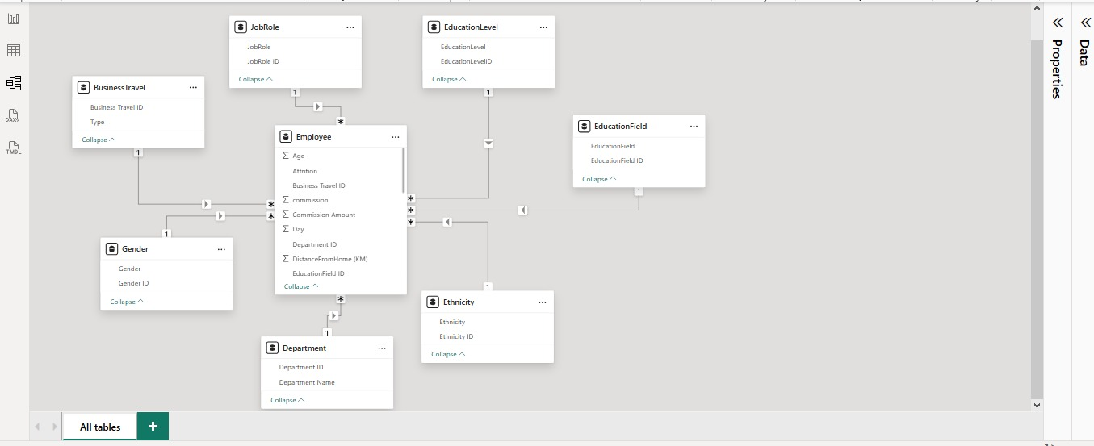
Modeling

Slide 8

Used Dax
Total emp = count(Employee[EmployeeID] )
Average salary = AVERAGE(Employee[Salary])
Attretion rate = [count of attrition]/[Total emp]
Median age = MEDIAN(Employee[Age])

Slide 9
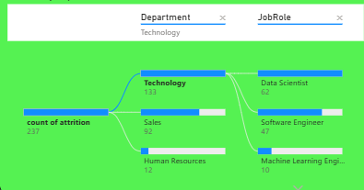
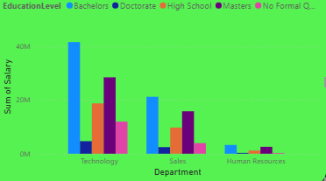
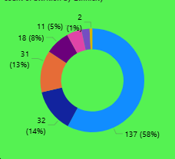
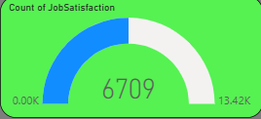
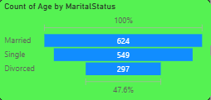
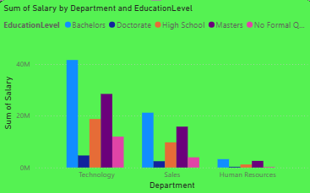
Sample Visuals

Slide 10
Thank you for your attention
Muhammad Abdel Azim
Tamer Rashad
Muhammad Dawood
Ahmed Saad

